Slide 1
The Role of Convection in Common Envelope Interactions for Massive Stars
July 12, 2019
Em Flynn
Mentor(S): Dr. Jason Nordhaus, Emily Wilson

Slide 2
Background
Binary system – two stars, one larger (primary) and one smaller (secondary)
Interaction produces common envelope
Convective zone – area of common envelope where energy is transported to the surface through molecule movement
Ejection efficiency – percentage of orbital energy available to unbind the common envelope
Convection carries energy away from the system, lowering the ejection efficiency

Slide 3
Project overview
Time-scale plots
Convective time-scale – how long it takes for convection to happen
Inspiral time-scale – how long it takes for the secondary to spiral into the primary
Luminosity
Max – maximum power accommodated by the convective envelope
Drag luminosity – luminosity generated by the inspiral of the secondary
Energy plots
Binding energy – how much energy it would take to remove the envelope
Change in orbital energy – energy released during inspiral
Shredding radius – point at which the secondary is shredded by the gravity of the primary

Slide 4
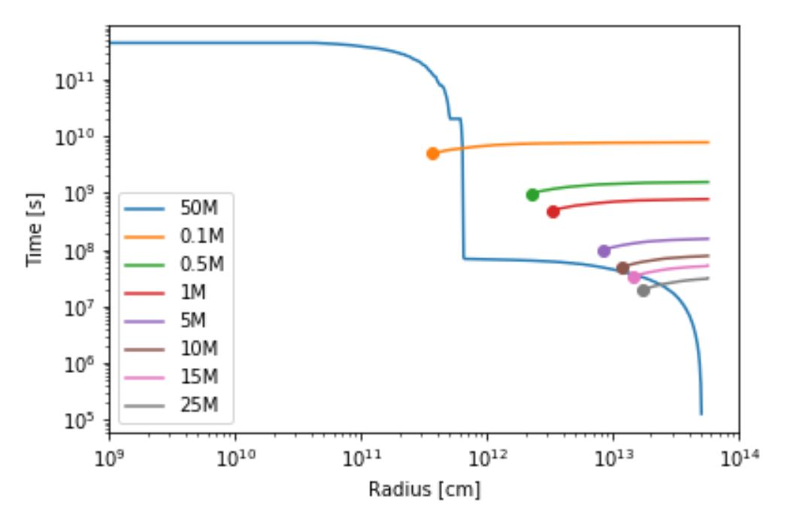
Comparative time-scale
Blue (50M) line: convective time-scale
Other lines: inspiral time-scales
Dots: shredding radius
If t_conv > t_inspiral: convection cannot move anything, because the star’s convective time-scale is greater than the time it takes for the secondary to move through the envelope
Else if t_conv < t_inspiral: convection can move limited energy (depends on luminosity)

Slide 5
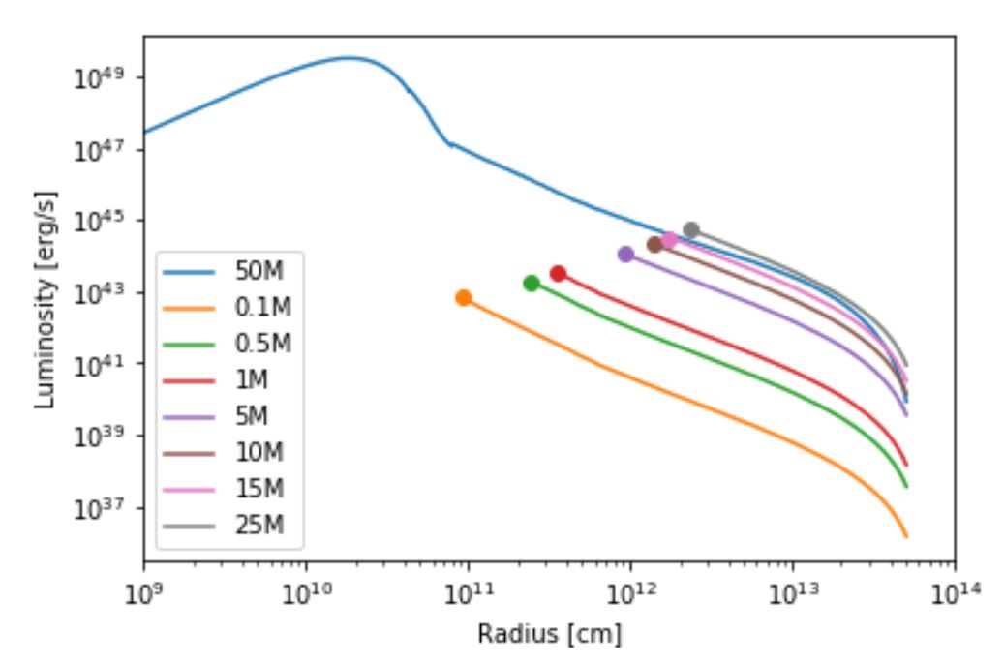
Luminosity
Blue (50M) line: maximum luminosity
Other lines: drag luminosity
Dots: shredding radius
If lum_max > lum_drag: convection can remove some liberated energy, but only up to lum_drag
Else if lum_max < lum_drag: convection can remove all liberated energy because the energy generated by the inspiral is greater than the maximum amount contained in the envelope
(Both dependent on time-scale)

Slide 6
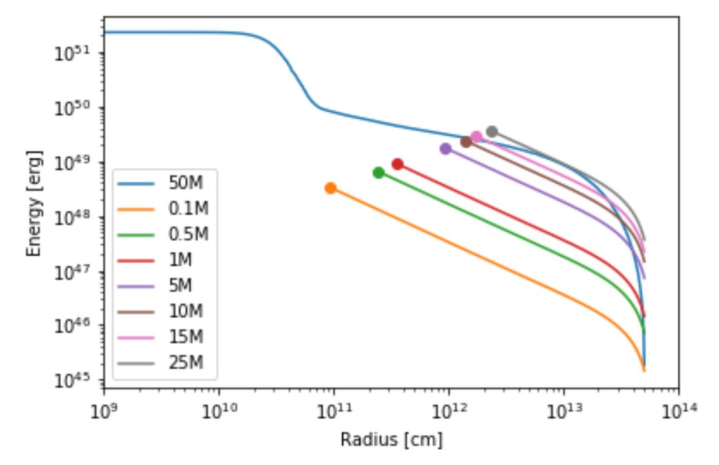
Energy
Blue (50M) line: binding energy for the primary star
Other lines: change in orbital energy during inspiral
Dots: shredding radius
If e_bind < e_orb at r_shred: enough energy is transferred to unbind the envelope
Else if e_bind > e_orb at r_shred: secondary will shred during inspiral before enough energy is transferred to unbind the envelope of the primary

Slide 7
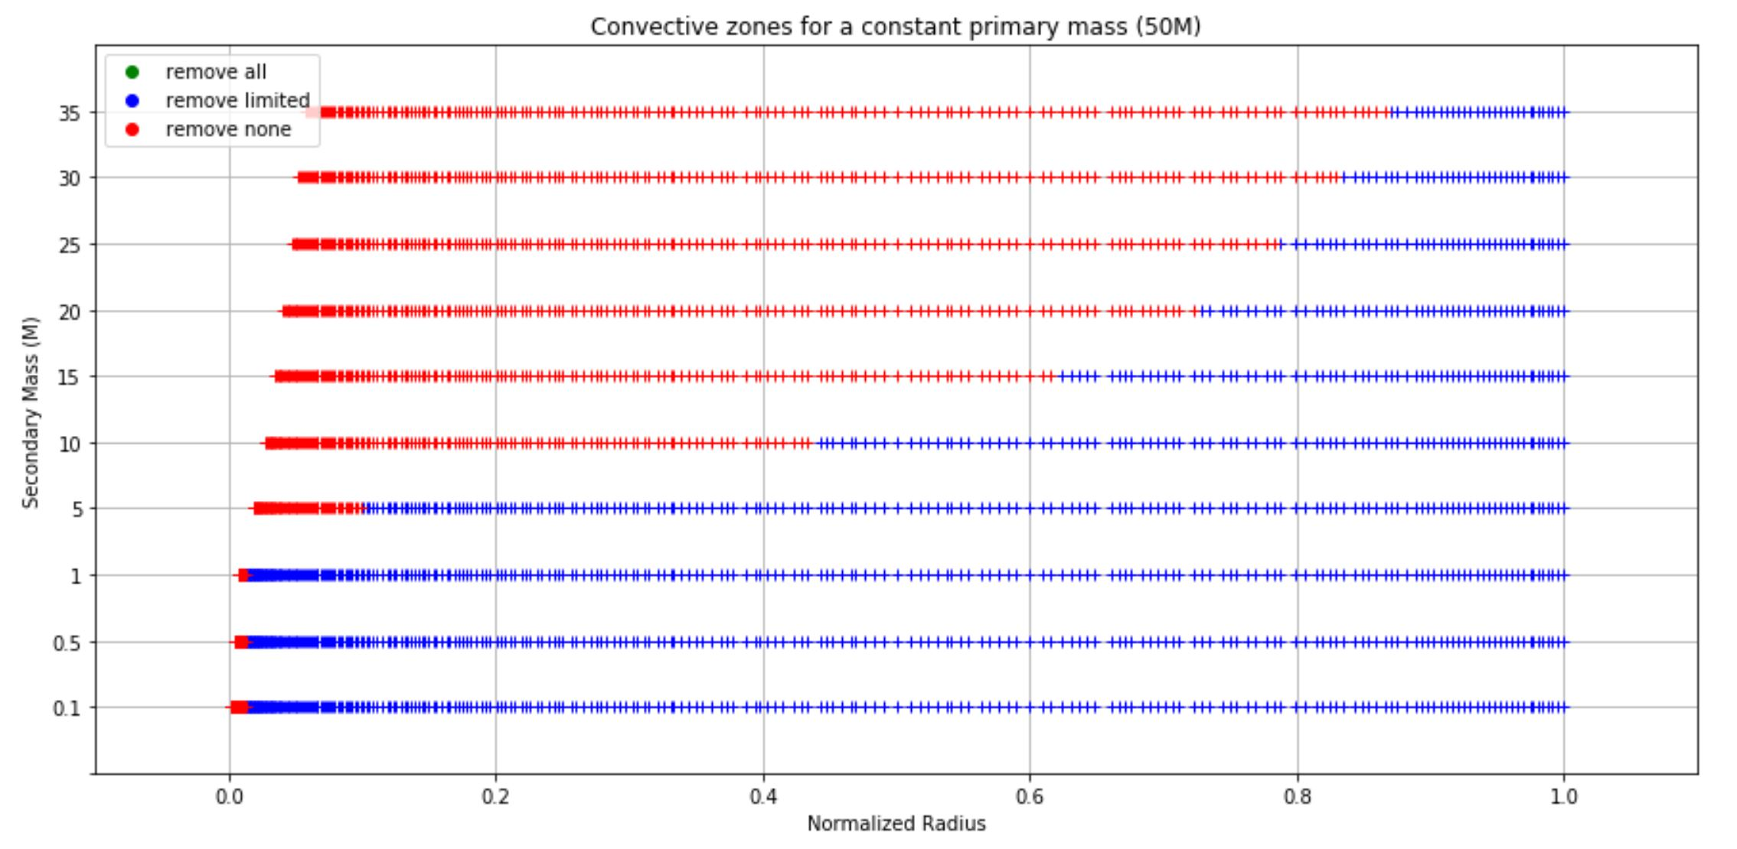
Convective Zones
Remove all energy: t_conv < t_inspiral & lum_max < lum_drag
Remove limited energy: t_conv < t_inspiral & lum_max > lum_drag
Remove no energy: t_conv > t_inspiral
As the mass of the secondary increases, it’s harder for energy to be removed

Slide 8
Next steps
Calculate the ejection efficiency – how much energy is radiated into space
Compare to the small (< 8M) stars from Wilson & Nordhaus, 2019

Slide 9


Acknowledgements

